Slide 1
Background and Foreground Modeling Using Nonparametric Kernel Density Estimation for Visual Surveillance(2002)
A. Elgammal,R. Duraiswami, D. Harwood, L. Davis
Presented by
Robert F.K. Martin
31 March 2009
Notes:
First publication was in 2001. This was July 2002 and added previous work with occlusion handling from a separate paper.

Slide 2
About the Authors
Ahmed Elgammal
  Ph.D. 2002 UMD, now at Rutgers
Ramani Duraiswami
  Ph.D. 1991 JHU, researcher at UMD
David Harwood
  MIT, researcher at UMD
Larry Davis
  Ph.D. 1976 UMD, professor at UMD
Notes:
Davis got his phd under Cohen???, at the time had 75 papers published

Slide 3
Background Modeling
Image of background model, image, and foreground

Slide 4
Background Modeling Issues
Illumination changes
  Moving clouds, movement of the sun, light switches
Motion
  Swaying trees, rippling water, camera motion
Stationary objects
  Cars at an intersection, people in crowds

Slide 5
Prior Work
Background “averaging”, IIR filters
Gaussian distributions
  Kalman filters
Mixture of gaussians
Lesser known methods
  HMM
  Edges
  Block matching
Notes:
Karmann worked on Kalman filters in 1990, Stauffer in 1999, HMM in 1999/2000

Slide 6
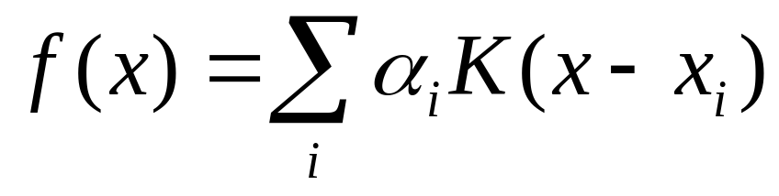
Kernel Density Estimation
Attempts to ascertain some underlying pdf
Also known as parzen windows
With sufficient data, will converge to actual density function

Slide 7
Kernel Density Estimation
Kernel function is typically a gaussian
  Can be any function as long it has unit area
Can be extended to multi-variate distributions
Has advantage over MoG of being able to represent complex pdfs

Slide 8
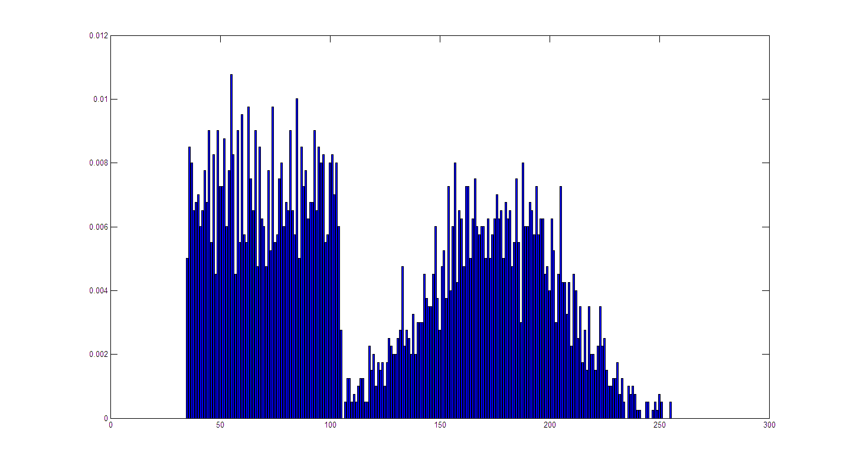
Kernel Density Estimation

Slide 9
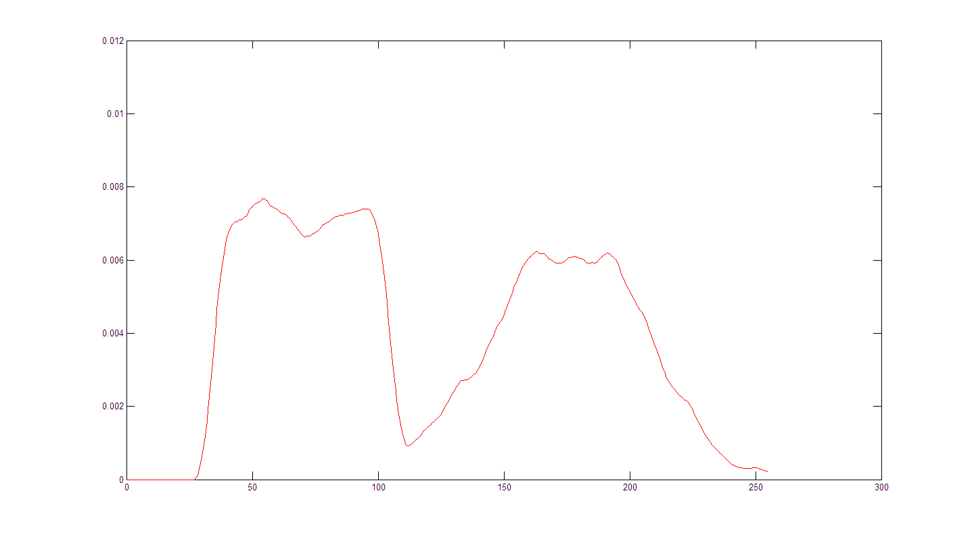
Kernel Density Estimation

Slide 10
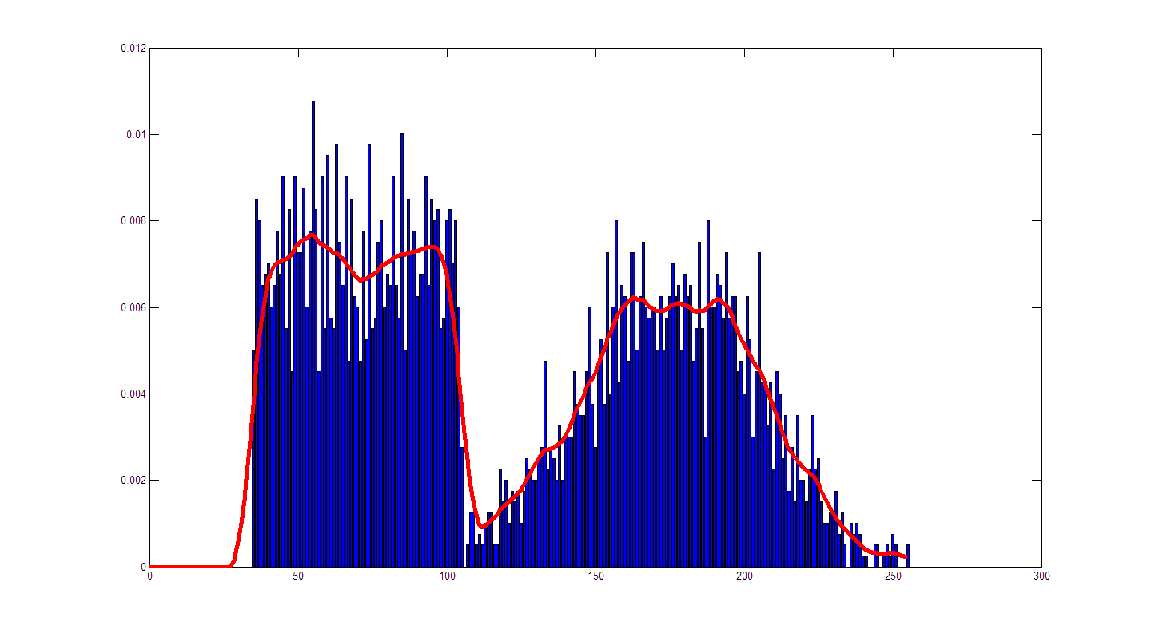
Kernel Density Estimation

Slide 11
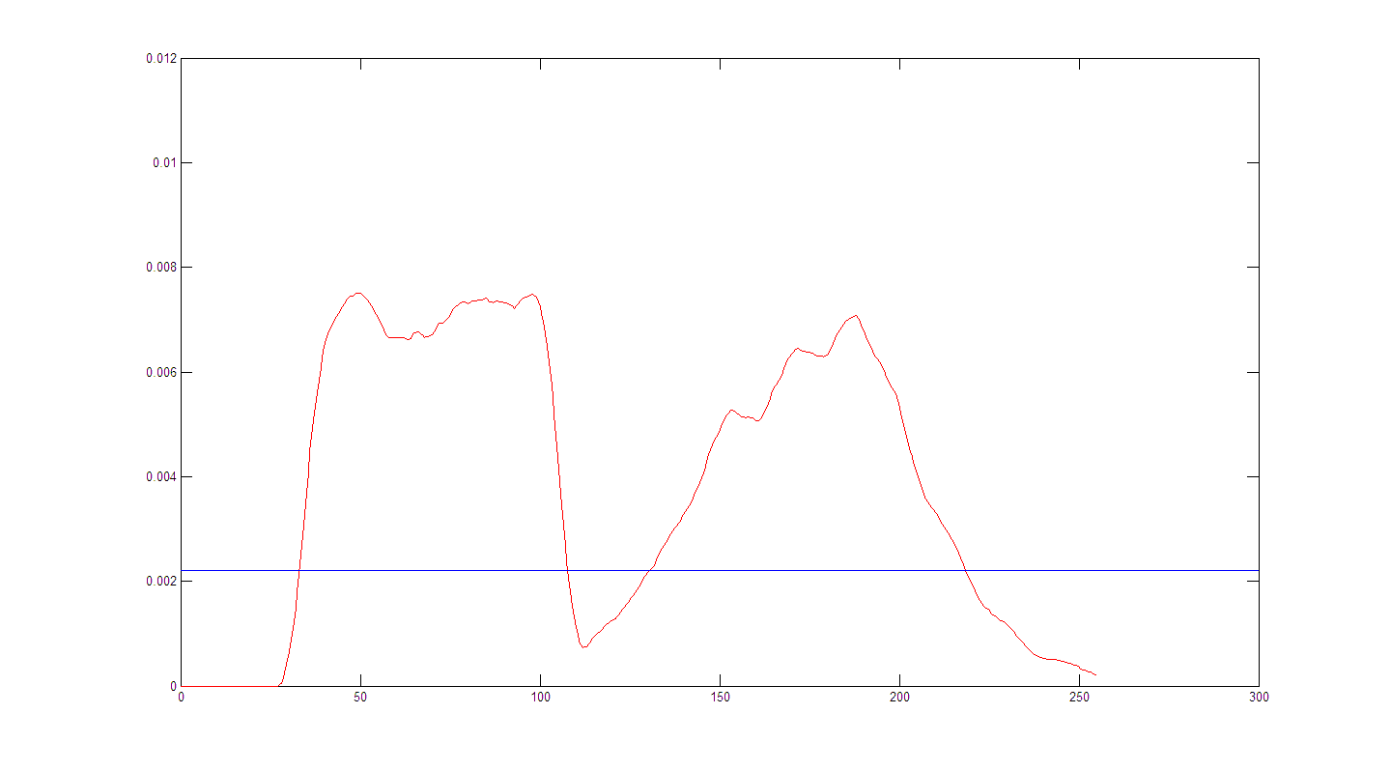
Kernel Density Estimation

Slide 12
Kernel Bandwidth
Bandwidth too large? Resulting pdf is too smooth
Bandwidth too small? Resulting pdf is too spiky
Goldilocks problem – need to find a bandwidth that’s just right.

Slide 13
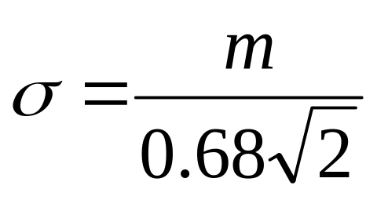
Kernel Bandwidth
Treat each color channel and pixel separately
Use temporal MAD to estimate bandwidth

Slide 14
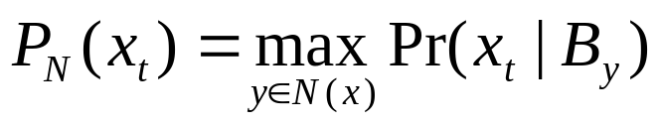
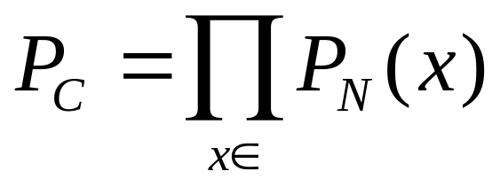
False Detection Suppression
To avoid noisy images, take max probability of neighborhood
To avoid losing true detections, the whole connected component must move

Slide 15
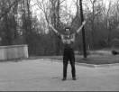
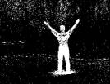
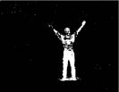
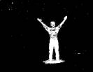
False Detection Suppression
Image source: http://www.umiacs.umd.edu/users/elgammal/docs/ECCV00-poster2.htm

Slide 16
Updating the Background
To adapt to changing lighting or scenery, sample only most recent pixels
Uses 2 models: short-term, long-term
  Short-term uses only current background pixels and samples closer in time
  Long-term uses all pixels spaced farther apart in time
  The two models are combined using AND and some morphological operators

Slide 17
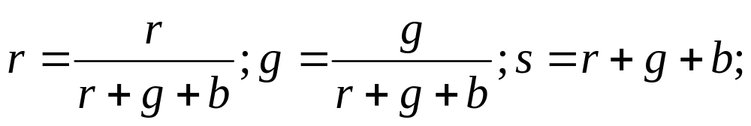
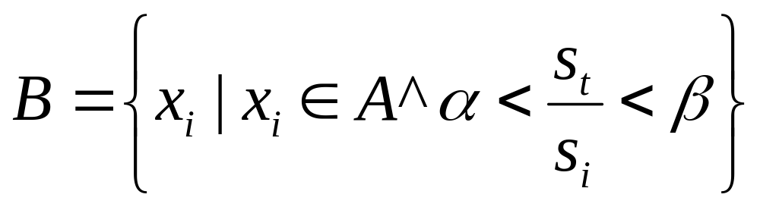
Shadow Suppression
Use additional constraint – chromaticity and lightness
Use lightness to constrain sample history for KDE

Slide 18
Computational Considerations
Gaussian computation can be quickened with lookup tables
In most cases, threshold is exceeded with a few calculations

Slide 19
Computational Considerations
Claim: 320x240, 400 MHz Pentium, grayscale, 50 samples/pixel: 15-20 frames/second
Further addressed in later paper
    C. Yang, R. Duraiswami, N.Gumerov, L. Davis. “Improved Fast Gauss Transform and Efficient Kernel Density Estimation”, Proceedings of the ICCV, 2003.

Slide 21


Slide 22
Questions?

